Slide 1
Introduction
Endocrine tissue is made up of cells that produce secretions which are poured directly into blood.
Endocrine cells lie in close apposition to blood capillaries or sinusoids.
Secretions of endocrine cells are called hormones.
Hormones travel through blood to target cells and influence their function.

Slide 2
The endocrine system includes:
Endocrine glands, such as the pituitary, thyroid and parathyroid, adrenal, and the pineal gland.
2. Clusters of endocrine cells located in the organs such as islets of Langerhans in the pancreas.
3. Isolated endocrine cells in certain tissues, such as the entero-endocrine cells in the epithelium of the respiratory and digestive tracts.
The organs or tissues that are activated by released hormones are called target organs or tissues. The cells in the target organ/tissue have appropriate receptors, which are able to recognize and respond to specific hormones.

Slide 3
Hormone: a chemical substance produced in the body that controls and regulates the activity of certain cells or organs.
The hormones can be divided into three classes based on their structure:
1.Steroid hormones are lipid hormones that have the characteristic ring structure of steroids and are formed from cholesterol. (e.g. estrogen, testosterone, cortisone, and aldosterone ).
2.Peptide hormones are composed of amino acids. The majority of hormones of this type are secreted by the pituitary gland (Adrenocorticotrophic hormone (ACTH), Thyroid-stimulating hormone (TSH), Follicle-stimulating hormone (FSH), Growth hormone (GH), and prolactin(PRL) and parathyroid glands (PTH).
3.Amine hormones are derived from the amino acid tyrosine.(e.g. T3&T4 released by the thyroid and adrenaline & noradrenaline secreted by the adrenal medulla).

Slide 4
The Endocrine Glands (Ductless glands)
Pituitary (hypophysis)
Anterior pituitary
Posterior pituitary
Adrenal gland (suprarenal)
Adrenal cortex
Adrenal medulla
Thyroid gland
Follicles
Parafollicular cells
Parathyroid gland

Slide 5
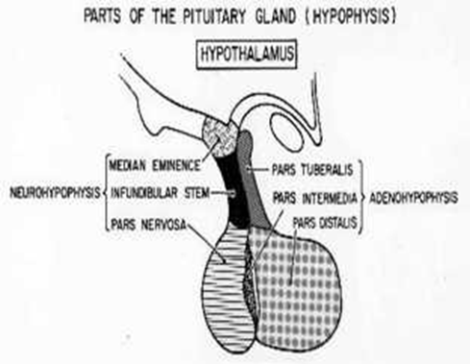
The pituitary gland is a neuroendocrine organ located inside the skull (in the sella turcica of the sphenoid bone) and considered a part of the brain.
It weighs about 0.5 g in adults &has dimensions of about 10 x 6 mm.
Embryogenesis:
The hypophysis develops partly from oral ectoderm and partly from nerve tissue.

Slide 6
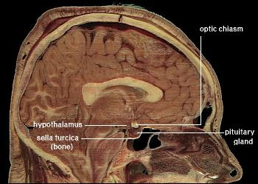
The Pituitary Gland (Hypophysis Cerebri)
a

Slide 7
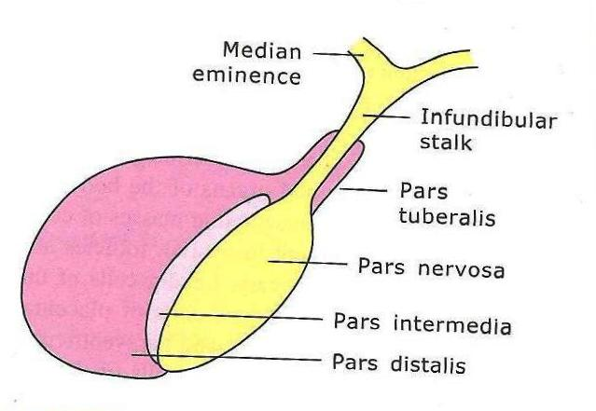
The Pituitary Gland (Hypophysis Cerebri)
“Master endocrine gland”.
Parts:
Adenohypophysis
(Anterior Pituitary): consist of pars distalis, pars intermedia & pars tuberalis.
Neurohypophysis
(Posterior Pituitary): consist of pars nervosa, infundibular stalk & median eminence.

Slide 8
Adenohypophysis
Pars Distalis:
It accounts for 75% of the mass of the hypophysis, it mainly consists of cords of epithelial cells (hormone-secreting cells) interspersed with fenestrated capillaries. With few fibroblasts producing reticular fibers that support these cords.
Cells are arranged as irregular cords in between thin-walled fenestrated sinusoids.
Consists of 2 major group of cells: chromophils & chromophobes.
Chromophils are of 2 types: basophils & acidophils.
Pars Intermedia:
Poorly developed in humans.
Consists mainly of basophils.
Presence of colloid filled vesicles.
Some cells produce melanocyte stimulating hormone (MSH).

Slide 9
Pars Tuberalis
The pars tuberalis is the neck of the adenohypophysis; it wraps around the infundibular stalk of the pituitary gland.
It contains a rich capillary network and some low columnar basophilic cells that are commonly arranged in cords.
Most of the cells of the pars tuberalis are basophilic gonadotropic cells that secrete follicle- stimulating hormone (FSH) and luteinizing hormone (LH).

Slide 10
Control of Secretion in the Adenohypophysis:
The activities of the cells of the anterior pituitary are controlled primarily by peptide hormones produced in hypothalamic nuclei and stored in their axons that run to the median eminence. Most of these hormones are hypothalamic-releasing hormones; liberated from the axons, they are transported by capillaries to the pars distalis where they stimulate hormone synthesis and/or release.
Two of the hypothalamic factors, however, act to inhibit hormone release by specific cells of the pars distalis (hypothalamic-inhibiting hormones).

Slide 11
Cells and hormones of the anterior pituitary
LM staining | Cell type | Hormone | Releasing (+) or inhibiting (-) horm.
Acidophil | Somatotrophs | Growth hormone (GH) = somatotropin | GHRH (+) Somatostatin (-)
Acidophil | Mammotrophs = lactotrophs | Prolactin (PRL) | [Dopamine (-) estrogen (+)]
Basophil | Thyrotrophs | Thyroid stimulating hormone (TSH) = thyrotropin | TRH (+)
Basophil | Gonadotrophs | Luteinizing hormone (LH), follicle stimulating hormone (FSH); both = gonadotropin | GnRH (+)
Basophil (human) | Corticotrophs | Adrenocorticotropin (ACTH) = corticotropin | CRH (+)

Slide 12
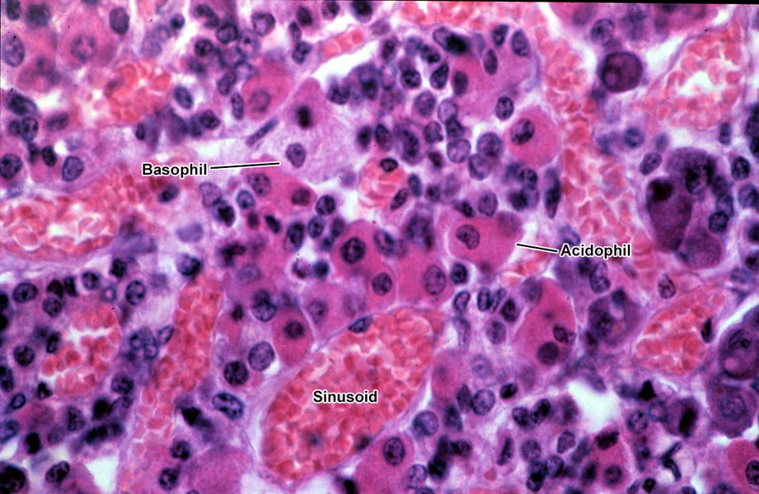
Anterior pituitary (H&E stain)
Basophil
Notes:
LM, human pituitary, stained with H&E.
From Stan Erlandsen Medical Histology slide set, slide MH-9B3. MH-9B3-L.jpg. 72(600)6.

Slide 13
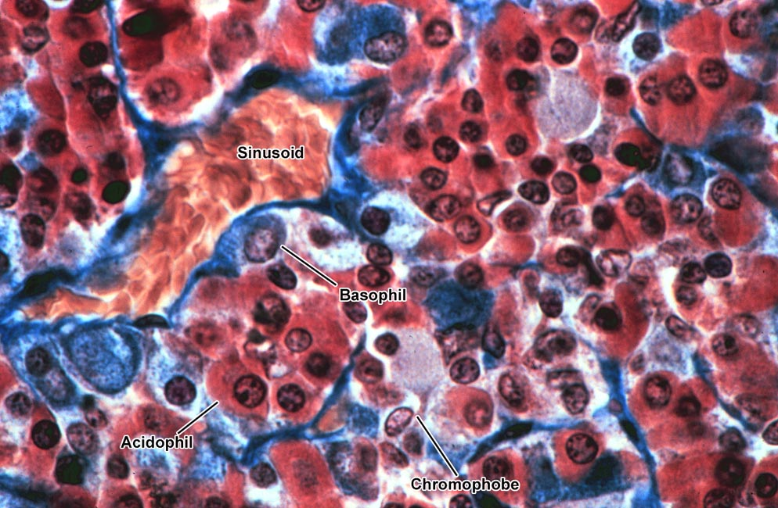
Anterior pituitary (trichrome stain)
Notes:
LM, anterior pituitary, stained with a trichrome stain. Acidophils (making growth hormone or prolactin) are red, and basophils (making thyroid stimulating hormone, LH/FSH, or ACTH) are blue or grayish. Note the sinusoid (large capillary), filled with red blood cells.
From Stan Erlandsen Medical Histology slide collection, slide MH 9/B/4. MH-9B4-L.jpg. 72(650)6.

Slide 14
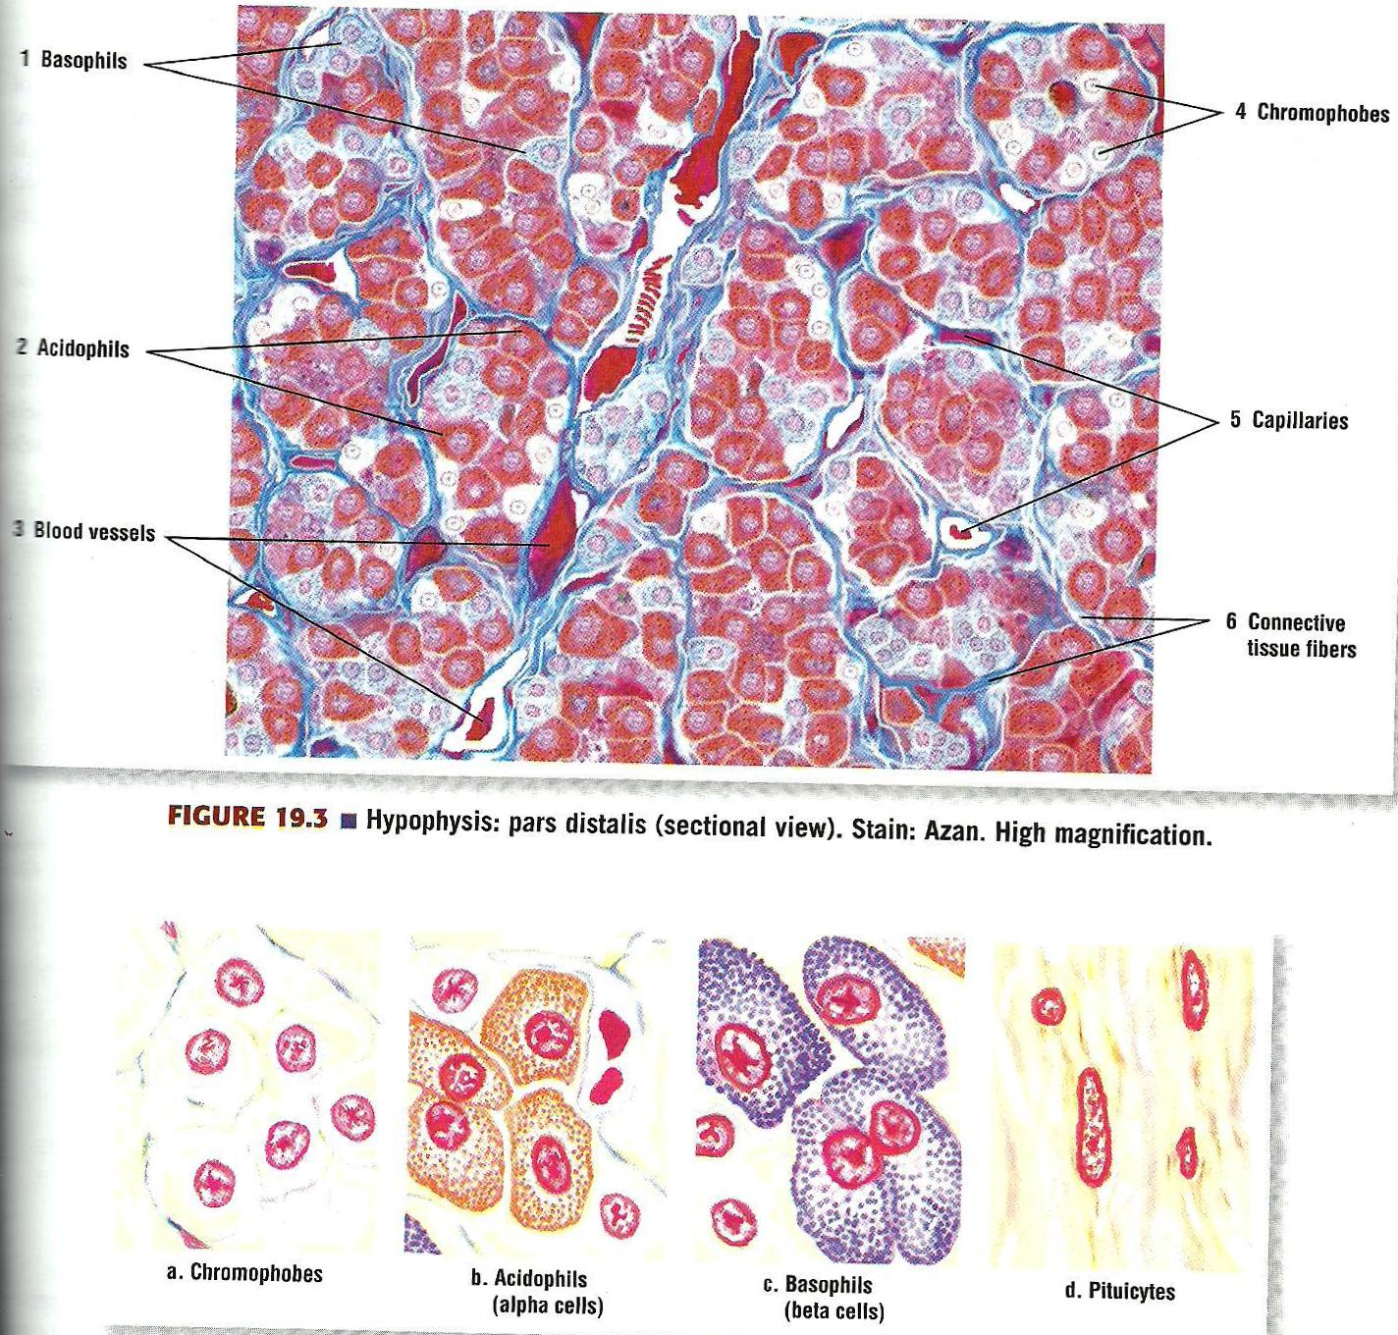
Pars distalis (Azan stain)

Slide 15
Neurohypophysis or Posterior Pituitary
Consists of:
Neurosecretion
Hormones synthesized as part of larger proteins (neurophysins) in neuron cell bodies of hypothalamus.
Transported in axons non-myelinated to pars nervosa (hormone cleaved from neurophysin).
Herring bodies: collection of secretory granules at the terminal portion of axonal processing.
Pituicytes specialized glia of pars nervosa and Supporting cells .
Produce 2 hormones:
Oxytocin
Vasopressin or antidiuretic hormone (ADH)

Slide 16
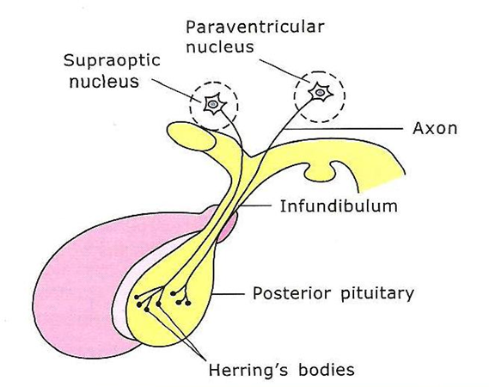

Slide 17
Posterior Pituitary

Slide 18
Hypophysis (Mallory-Azan & orange G. stain)

Slide 19
Hypophysis (H&E stain)

Slide 20
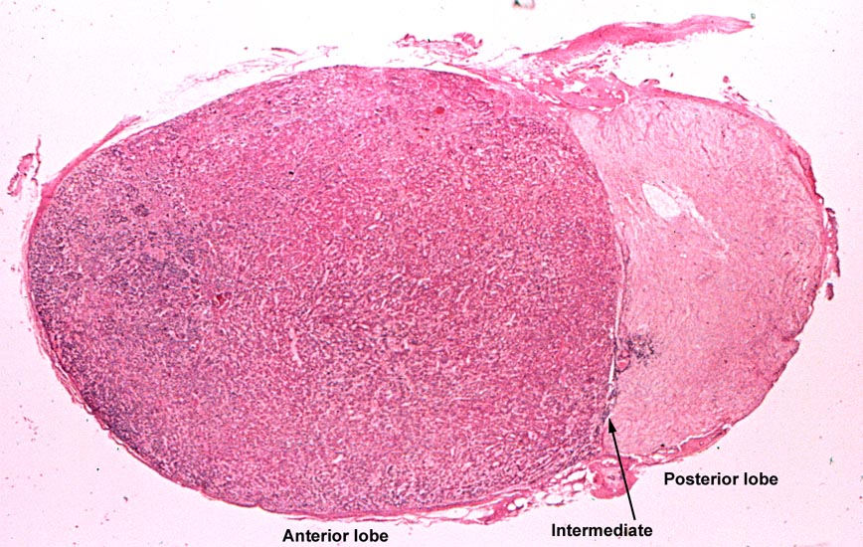
Pituitary gland
Notes:
LM, human pituitary, at low power.
From Japanese slide set (Humio Mizoguti, Kobe Univ Sch Med), slide 515 (= 57-1). Japan515-L.jpg. 72(550)6.

Slide 21
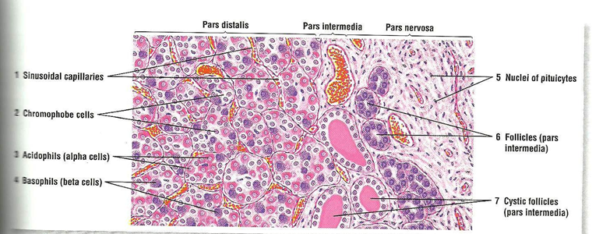

Slide 22
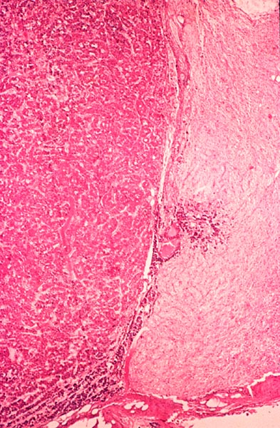
Pars intermedia, between anterior and posterior pituitary (Poorly developed and of doubtful function in humans)
Anterior
Posterior
Intermedia
Notes:
LM, human pituitary, showing anterior (at left) and posterior (at right) lobes. The pars intermedia ("intermediate lobe") is very poorly developed in humans, and consists merely of a modest layer of darker cells lying against the posterior lobe, to the right of the white cleft between the anterior and posterior lobes.
From Japanese slide set (Humio Mizoguti, Kobe Univ Sch Med), slide 516 (= 57-2). Japan516.jpg. 72(600)6.

Slide 23
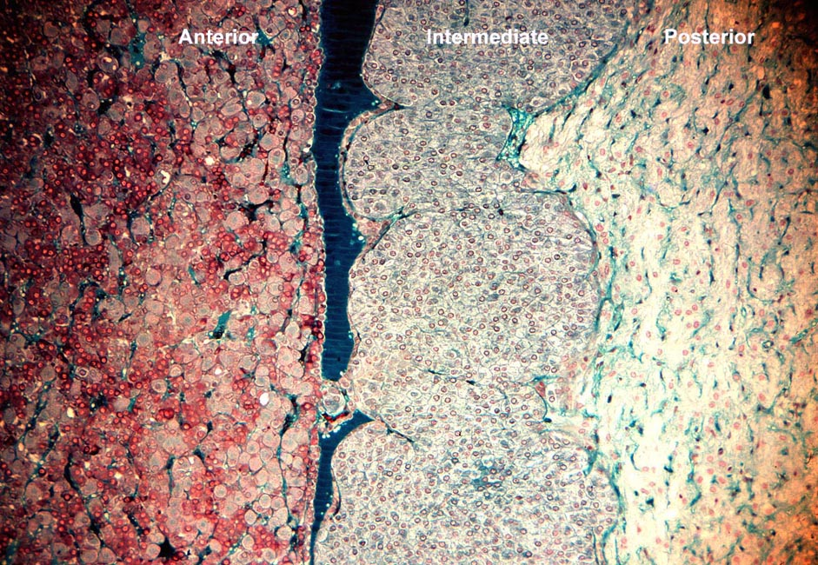
Pars intermedia (rat pituitary)
Rathke's pouch
Notes:
LM, rat pituitary, showing the prominent pars intermedia seen in the pituitary of non-human mammals. Anterior pituitary, pars intermedia, and posterior pituitary are labeled.
Taken by AKC from a Burton L. Baker LM slide. 1980C28(59)CL.jpg. 72(650)6.

Slide 24
Blood Supply & the Hypothalamo-Hypophyseal Portal System:
The blood supply of the hypophysis derives from the internal carotid artery:
From above, the superior hypophyseal arteries supply the median eminence and the neural stalk
The superior hypophyseal arteries form a primary capillary network irrigating the stalk and median eminence. The capillaries then rejoin to form venules that branch again as a larger secondary capillary network in the adenohypophysis, Capillaries of both networks are fenestrated.
From below, inferior hypophyseal arteries provide blood mainly for the neurohypophysis, with a small supply to the stalk.

Slide 26
THYROID GLAND

Slide 27
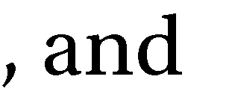

Slide 28
Secrete 2 hormones: tri-iodothyronine (T3) & tetra-iodothyronine (T4) or thyroxine.

Slide 29
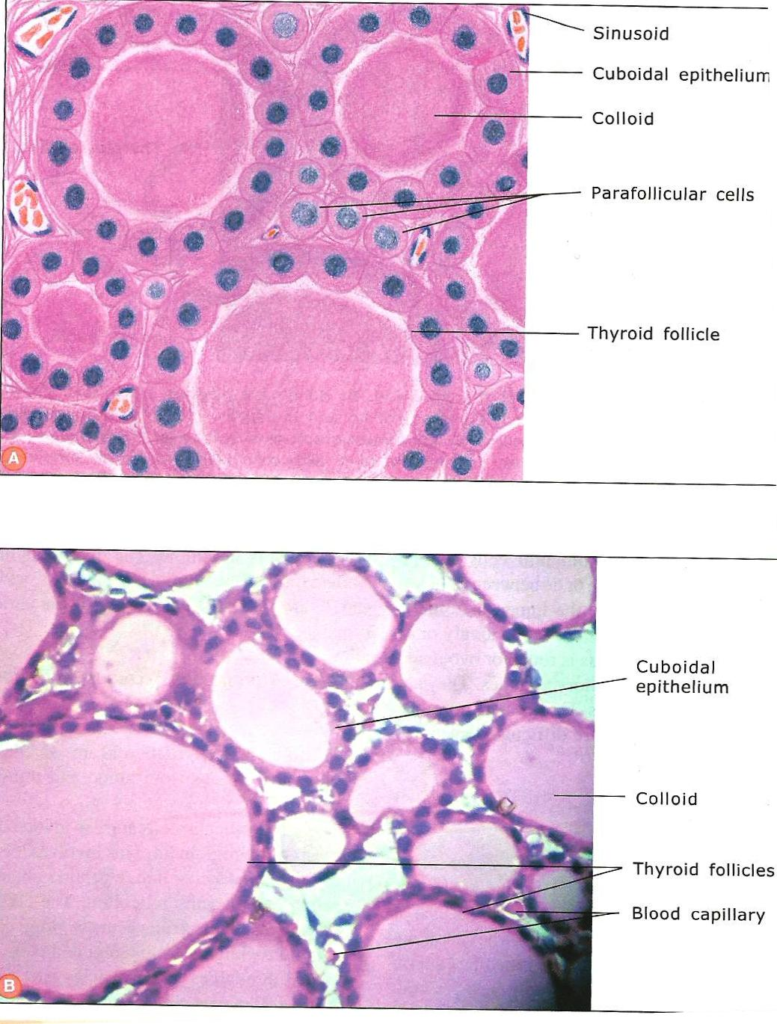

Slide 31
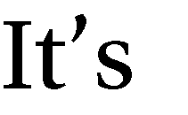
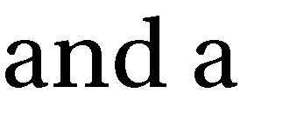
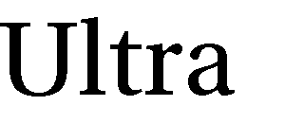
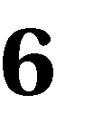
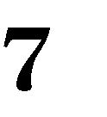
Or (C-cells):

Slide 32
Parathyroid Gland

Slide 33
Parathyroid Gland (H&E stain)

